Slide 1


Future of SE Research:
Research for SE,
SE for Research
tim.menzies@gmail.com
http://menzies.us
October 2015!
Slides: tiny.cc/gale15

Slide 2

Roadmap
Increasing use of “discover” software tools
Systematic errors in the “discover” software
Next gen software tools to reduce those errors
Prelim results

Slide 3
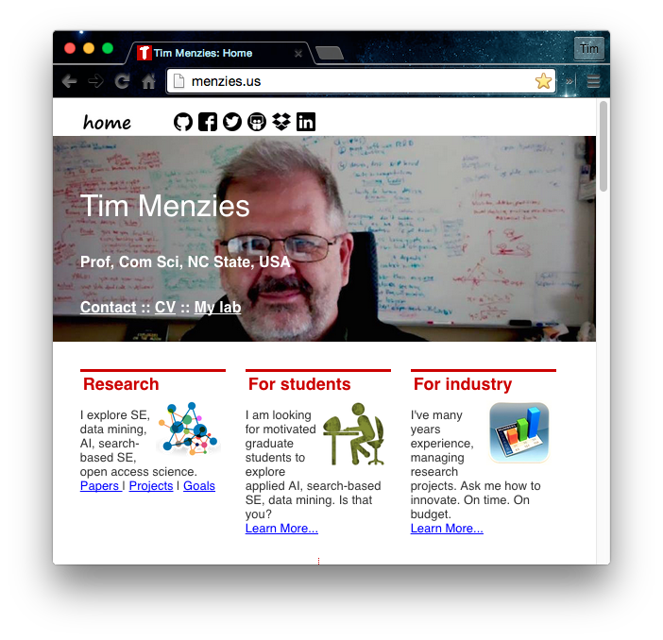
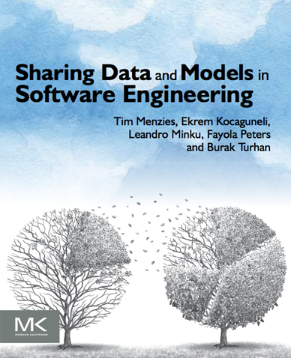
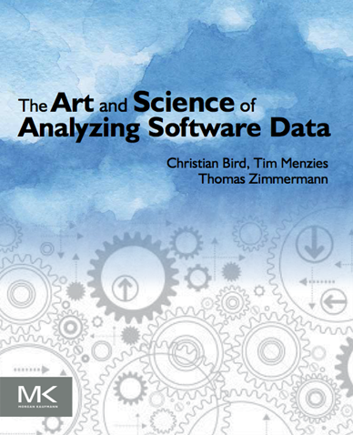
Me
Full Prof in CS NC State. Teaches SE and automated SE.
Researches synergies human+AI, with focus on data mining for SE.
Assoc editor IEEE Transactions on SE, Empirical SE, the Automated SE Journal , Software Quality Journal
Was co-PC-chair for ASE’12, ICSE'15 NIER track.
Will be co-general chair of ICMSE'16.
Author of 230+ referred pubs.
One of the 100th most cited authors in SE (of 80,000 http://goo.gl/BnFJs).
PI for NSF, NIJ, DoD, NASA, USDA, and research work with private companies.
Co-founder of the PROMISE conference series on reproducible experiments in SE.
Current curator PROMISE web site, SE research data http://openscience.us/repo .
Vita: http://goo.gl/8eNhYM
Pubs: https://goo.gl/qNQAIq
Home page: http://menzies.us

Slide 4
But before we start….
…. why that roadmap?

Slide 5


Welcome to my “Minority Report”
For the “majority” report
E.g.
Basili: http://goo.gl/iokyyn (how to build and share conclusions?)
Boehm: http://goo.gl/QDzuTU (what trends did we miss?)
Broy: http://goo.gl/r04cpx (SE needs extensive domain models)
For another perspective,
Please stay in your seat

Slide 6
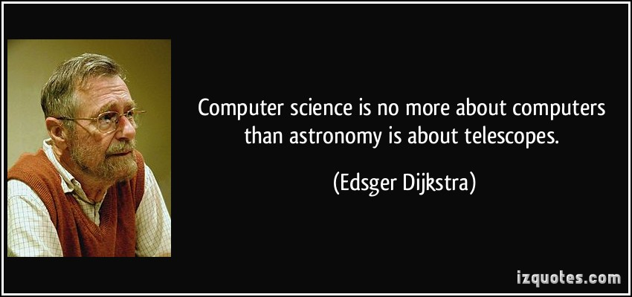
Software engineering researchers just studying software is like astronomers just studying telescopes.
After we grind the lenses, we should look through the scope.
After we build the software, we see how people are using it

Slide 7
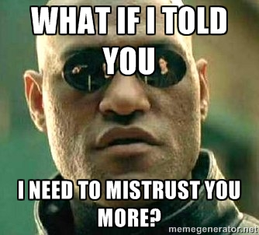
Software tools for “citizen scientists”
Science has escaped the lab and is roaming free in the world.
People use software to understand the world
What tools are needed to support that work?
Want to mistrust the conclusions of the citizen scientists
Just as we mistrust and evaluate, review, explore, evolve the conclusions of any other scientist.

Slide 8
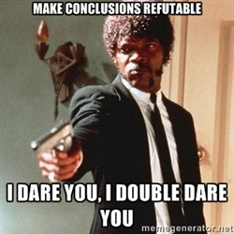
When every citizen can be a scientist (making generalizations from data)
It should be possible to for everyone else to
audit a conclusion;
to repeat (at least in part) the processes that lead to that conclusion;
to reconsider parts of old conclusions;
to decide what a conclusion from some other site does/does not apply locally.

Slide 9
Q: But is this an SE issue?
A: Yes

Slide 10
Confucius: “Study the past if you would define the future”
History of SE
X is not part of SE
People are having trouble with X
Experiments: Extend SE to include X
Conclusion: “you know what? SE tool support makes X easier”

Slide 11
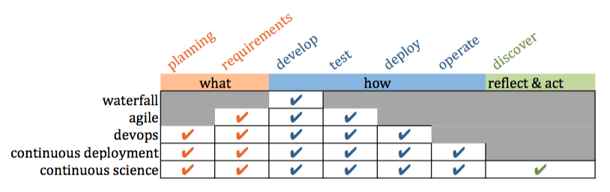
Confucius: “Study the past if you would define the future.”
History of SE
X is not part of SE
People are having trouble with X
Experiments: Extend SE to include X
Conclusion: “you know what? SE tool support makes X easier”

Slide 12
Confucius: “Study the past if you would define the future.”
Future of SE
Software mediates what we see and how we act in the world
Everyone with software is now a scientist
Software supports communities as they judge conclusions

Slide 13
To find the future, extrapolate the past
Future of SE
Software mediates how everyone sees and acts on the world
Everyone with software is now a scientist
Software supports communities as they judge conclusions

Slide 14
Is my perspective right? (or useful)?
Yes, if I can show:
Increasing use of “discover” software tools
Systematic errors in the “discover” software
Next gen software tools to reduce those errors
Prelim results

Slide 15
Is my perspective right? (or useful)?
Yes, if I can show:
Increasing use of “discover” software tools
Systematic errors in the “discover” software
Next gen software tools to reduce those errors
Prelim results

Slide 16
Is my perspective right? (or useful)?
Yes, if I can show:
Increasing use of “discover” software tools
Systematic errors in the “discover” software
Next gen software tools to reduce those errors
Prelim results
prediction | planning | contexts/clustering/customization | optimization | certification envelopes | compression
privacy | anomaly detectors | sharing | pollution markers | repair operators | streaming

Slide 17

Is my perspective right? (or useful)?
Yes, if I can show:
Increasing use of “discover” software tools
Systematic errors in the “discover” software
Next gen software tools to reduce those errors
Prelim results
prediction | planning | contexts/clustering/customization | optimization | certification envelopes | compression
privacy | anomaly detectors | sharing | pollution markers | repair operators | streaming

Slide 18
Roadmap
Increasing use of “discover” software tools
Systematic errors in the “discover” software
Next gen software tools to reduce those errors
Prelim results

Slide 19
Roadmap
Increasing use of “discover” software tools
Systematic errors in the “discover” software
Next gen software tools to reduce those errors
Prelim results

Slide 20
Software mediates what we see and how we act in the world
Silicon valley developers view every new feature as an experiment, to be tested within some mash up to existing services.
Chemists win Nobel Prize for software simulations of molecules at various scales http://goo.gl/Lwensc
Engineers use software to tune systems as diverse as optical tweezers, radiation theory, microbiological exposure assessment, remote sensing, and silicon chips; http://goo.gl/qBMyIZ
Web analysts use software to analyze clickstream data to decide how to improve sales and marketing strategies; http://goo.gl/b26CfY

Slide 21
Software mediates what we see and how we act in the world
Algorithmic traders write software to prototype and simulate trading strategies on finance data; http://www.quantopian.com
Analysts write software to mine labor statistics data to predict the merits of proposed government policies http://goo.gl/X4kgnc
Journalists use software to analyze economic data and make visualizations their news stories http://fivethirtyeight.com
If you live in London or New York and need to call an ambulance, that ambulance is waiting for your call at a location pre-determined by a software model http://goo.gl/8SMd1p

Slide 22
Software mediates what we see and how we act in the world
If you cross from Mexico to Arizona, biometrics software decides if you need secondary screening http://goo.gl/Zk8IW4
The power to make your toast comes from a genera tor that was spun-up in response to software predicting your future electrical demands http://goo.gl/bfAiOR
If you fly a plane, software controls many aspects of flight, including what to do in emergency situations http://goo.gl/ocw6zj
If you have a heart attack, the software in the defibrillator will decide how to shock your heart and lungs so that you might live a little longer http://goo.gl/wxaikf

Slide 23
Software mediates what we see and how we act in the world
Etc, etc, etc

Slide 24
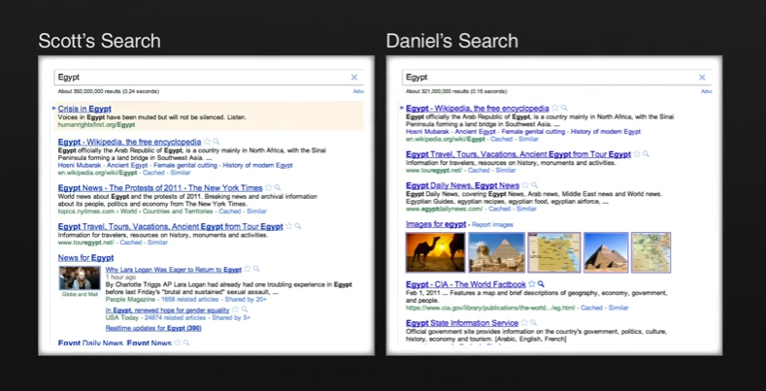
Software divides us
See also “Facebook emotion study breached ethical guidelines, researchers say” June 30, 2014, The Guardian http://goo.gl/gTRkmp

Slide 25
Roadmap
Increasing use of “discover” software tools
Systematic errors in the “discover” software
Next gen software tools to reduce those errors
Prelim results

Slide 26
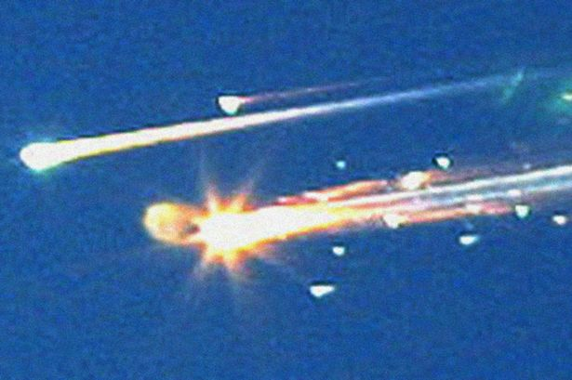
Issues with bad software models
Columbia ice strike
Size: 1200 m²
Speed: 477 mpg (relative to vehicle)
Certified as “safe” by the CRATER micro-meteorite model.
A experiment in CRATER’s DB:
Size: 3cm³
Speed: under 100 mpg
Columbia, and crew, dies on re-entry
Lesson: conclusions should come with a “certification envelope”
If new tests outside of the envelope of the training set
Raise an alert

Slide 27
Issues with over-storage
Facebook, Google, Netflix etc
Small X% of all users are subjects in continual experiments: testing new features
Data from studies, retained indefinitely, warehoused
Problems with volume (needs compression)
Problems with confidentiality (needs privacy)
If I want to challenge the conclusions made by Facebook, Google, Netflix, etc
I need to be able to access, privately, that data
(needs trusted sharing)

Slide 28
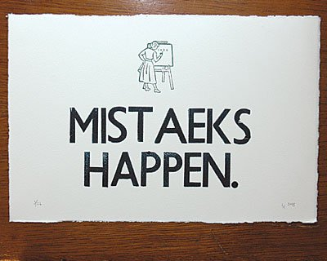
Issues with scripting errors
Inevitable, due to the complexity &novelty of our work
(But rarely reported, which is…. suspicious)

Slide 29
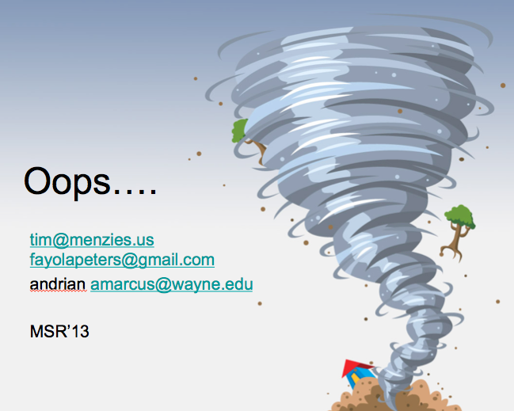
Issues with scripting errors
Mar 15: paper accepted to MSR13
“Better cross-company defect prediction”
Mar 29: camera-ready submitted,
?Apr 10: pre-prints go on-line
April 29: Hyeongmin Jeon, graduate student at Pusan Natl. Univ.,
Emailed us: can’t reproduce result
May 4: Peters, checking code, found error
Manic week of experiments ….
May11: results definitely wrong
Emails to MSR organizers
Our punishment? Present the paper and its error
Btw, < 3 weeks. Wow…

Slide 30
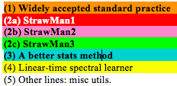
Code used in my last paper (1100 LOC of Python calling scikitlearn)

Slide 31
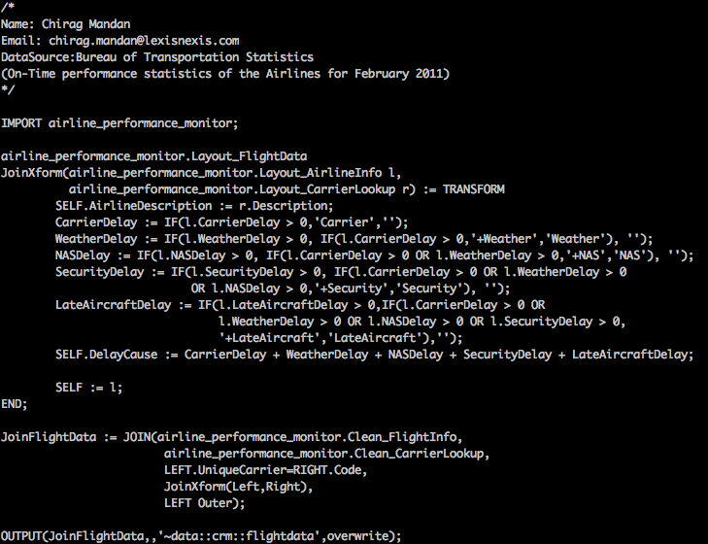
Scripting error issues: use higher-level languages?
ECL: a higher-level set-based language (more succinct)
But if you can write it quick,
you can write it wrong, quick.
Implications for
markets, ambulances, government policies, homeland security, toasters. Air safety, Nobel prizes, web-company advertising polices, do we take the family to Cairo for a holiday, etc etc

Slide 32
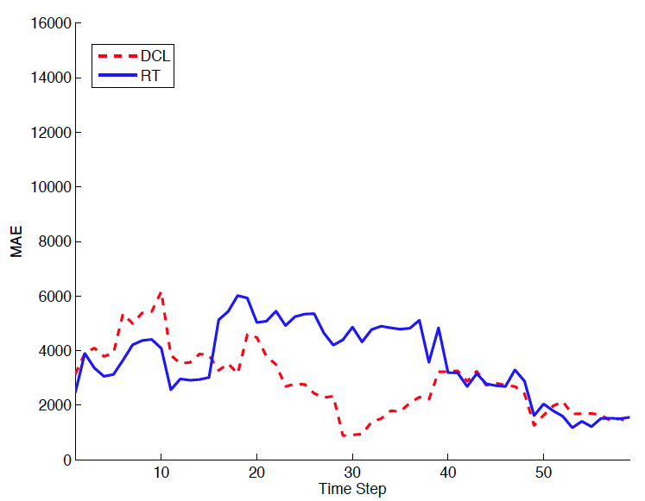
The variability problem
Devanbu et al. ASE’11 Ecological Inference
Betternburg et al. MSR’12 Think local, act global,
Menzies et al. TSE’13 Local versus Global learning,
Yang et al. IST’13 Handling local bias,
Minku et al. ICSE’14 Best Use of Cross-Company Data
Using ensemble data
Using local data
Error (less is better)

Slide 33
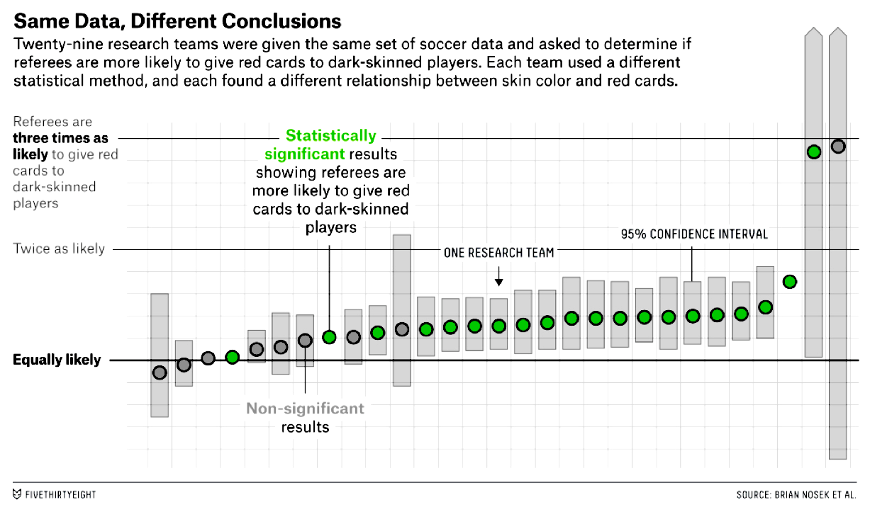
Issues with analyst choices
http://fivethirtyeight.com/features/science-isnt-broken/

Slide 34
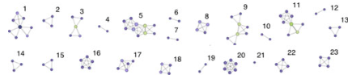
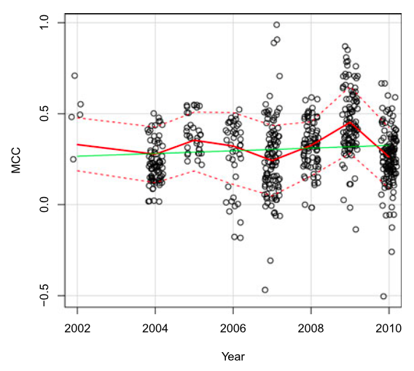
Issues with analyst choices
Software analytics
Defect prediction
Many of the same learners,
Many of the same data sets
42 papers, top journals,
23 author groups
2002 to 2010
Y-axis measures mean performance
Researcher Bias: The Use of Machine Learning in Software Defect Prediction, Martin Shepperd, David Bowes, and Tracy Hall, IEEE TRANS on Soft. Eng. , 40(6), JUNE 2014

Slide 35
Roadmap
Increasing use of “discover” software tools
Systematic errors in the “discover” software
Next gen software tools to reduce those errors
Prelim results

Slide 36
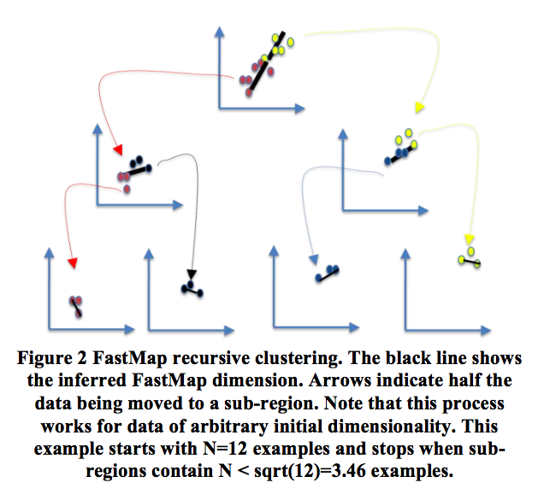
WHERE: fast spectral top-down divisive clustering
Spectral: works on eigenvectors
Fast: works on an approximation to eigenvectors (the FASTMAP heuristic) Faloutsos [1995]. A O(2N) generation of axis of large variability
Pick any point X;
Find E= East = furthest from X,
Find W = West furthest from East.
East, West = “the poles”
All points have distance a,b to (E,W)
c = dist(E,E)
x = (a² + c² − b²)/2c
Find median(x), recurse on each half

Slide 37
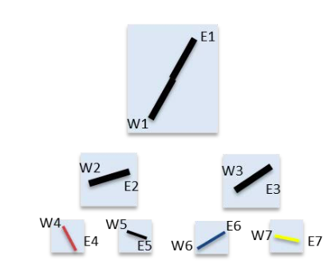
clustering ➔ compression (poles = approximate shape of data)
Ekrem XXX variance cunstrees

Slide 38
clustering ➔ compression (poles = approximate shape of data)
Andrew Butcher (WVU) and me, TSE’13, Local versus global. Models from all data have worse medians and larger variances than models from WHERE’s clusters

Slide 39
compression ➔ prediction
Call each leaf one “class”
Run a decision tree learner to find a model for the “classes”
Vasil Papakroni, WVU masters thesis, 2012
Prediction using WHERE’s clusters works
Just as well as other standard methods
(for software effort and defect estimation)

Slide 40
prediction ➔ planning
If the prediction is “bad”
Find a nearby leaf with “better” predictions
Branch1= decision branch to “bad”
Branch2 = decision branch to “better”
Plan = Branch2 – Branch1
Rahul Krishna (Ph.D. scholar, NC state) and me, submission to ICSE’16. Planning over WHERE
clusters very effective

Slide 41
compression ➔ privacy
Don’t share all the data, just the poles.
100% privacy on data not in poles
Don’t share the poles exactly,
Mutate them slightly, along, away from axis
Hides the individuals, preserves the shape of the data

Slide 42
compression ➔ anomaly detection
WHERE’s trees are a O(log(N)) time index to the leaves
Test data is “alien” if, after falling to its nearest leaf, it is outside of the poles

Slide 43
anomaly detection ➔ certification envelope
If new test case anomalous
Then flash some warning (test data out of scope of training data! conclusions may be wrong! )

Slide 44
anomaly detection ➔ pollution marking
Mark in as polluted all sub-trees with more than X% anomalies
When making conclusions, stay away from the polluted sub-trees

Slide 45
pollution marking ➔ incremental repair
In all sub-trees, keep a sample of data plus any anomalies
When too many pollution markers, recluster just that sub-tree
Dianne Gordon-Spears (2002): such hierarchical incremental repair 10,000 times faster than global reorganizations

Slide 46
incremental repair ➔ streaming
Incremental repair a.k.a. stream mining

Slide 47
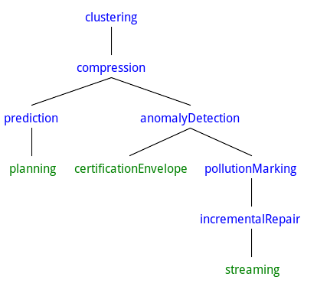
From compression to privacy to sharing
Create a community of data owners
Pass aro
[clustering [compression [prediction planning ] [anomalyDetection certificationEnvelope [pollutionMarking [incrementalRepair streaming]]]]]
Peters, Menzies, LACE2, ICSE’14

Slide 48
Roadmap
Increasing use of “discover” software tools
Systematic errors in the “discover” software
Next gen software tools to reduce those errors
Prelim results
Frequently asked questions

Slide 49

Our data mining tools should, and can, do more
Operating systems do more than just schedule processes.
They offer many other services
File systems
Network connections
Memory management
Journaling
Etc
Data mining tool kits should offer more than just predictors.
A whole host of facilities for sharing, privacy, compression, planning, anomaly detection, etc etc
Turns out, there are simple data structures that can support all the above
This talk: WHERE (but no doubt there are other data structures as well)
ai4se.net

Slide 50
Better data mining tools
What they do right now
prediction | planning | contexts/clustering/customization | optimization | certification envelopes | compression
privacy | anomaly detectors | sharing | pollution markers | repair operators | streaming

Slide 51
Better data mining tools
What they do right now
What they do could do
prediction | planning | contexts/clustering/customization | optimization | certification envelopes | compression
privacy | anomaly detectors | sharing | pollution markers | repair operators | streaming

Slide 52
Vasil Papakroni, WVU masters thesis, 2012
Andrew Butcher (WVU) and me,
TSE’13, Local versus global.
Rahul Krishna (Ph.D. scholar, NC state) and me, submission to ICSE’16.
Joe Krall (Ph.D. WVU) and me,
GALE, TSE’15.
prediction | planning | contexts/clustering/customization | optimization | certification envelopes | compression
privacy | anomaly detectors | sharing | pollution markers | repair operators | streaming
Peters, Menzies, Morph, Cliff, TSE’13; LACE2, ICSE’14

Slide 53
Roadmap
Increasing use of “discover” software tools
Systematic errors in the “discover” software
Next gen software tools to reduce those errors
Prelim results
Frequently asked questions

Slide 54
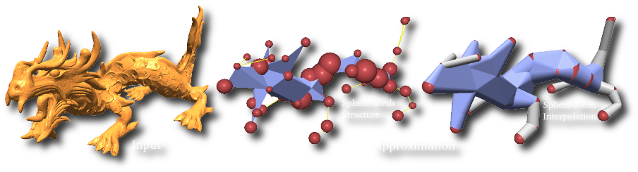
When searching for solutions “you don’t need all that detail”
In Computer
Graphics
In Machine learning
In Theorem proving
In Software Eng.
Variable subset selection (Kohavi, 1997)
Instance selection (Chen, 1975)
Active learning
Narrows (Amarel, 1986)
Master variables (Crawford 1995)
Back doors (Selman 2002).
Saturation in mutation testing (Budd, 1980 and many others

Slide 55
This talk
What is search-based SE?
Why use less CPU for SBSE?
How to use less CPU
Refactor the optimizer:
Add in some data mining
Experimental results
Related Work
Future work
A challenge question:
Are we making this too hard?
ai4se.net

Slide 56
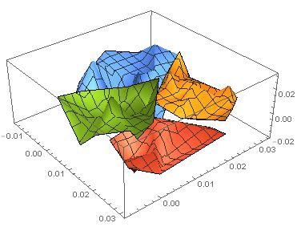
How to use less CPU (for SBSE)
Objectives = evaluate(decisions)
Generations *( Selection + Evaluation * Generation)
G * ( O(N²) + E * O(1)*N )
ai4se.net

Slide 57
How to use less CPU (for SBSE)
Objectives = evaluate(decisions)
Generations * (Selection + Evaluation * Generation)
G * ( O(N²) + E * O(1)*N )
Approximate the space
k=2 divisive clustering
ai4se.net

Slide 58
How to use less CPU (for SBSE)
Objectives = evaluate(decisions)
Generations * (Selection + Evaluation * Generation)
G * ( O(N²) + E * O(1)*N )
Approximate the space
k=2 divisive clustering
(X,Y)= 2 very distant points in O(2N)
ai4se.net

Slide 59
How to use less CPU (for SBSE)
Objectives = evaluate(decisions)
Generations * (Selection + Evaluation * Generation)
G * ( O(N²) + E * O(1)*N )
Approximate the space
k=2 divisive clustering
(X,Y)= 2 very distant points in O(2N)
Evaluate only (X,Y)
ai4se.net

Slide 60
How to use less CPU (for SBSE)
Objectives = evaluate(decisions)
Generations * (Selection + Evaluation * Generation)
G * ( O(N²) + E * O(1)*N )
Approximate the space
k=2 divisive clustering
(X,Y)= 2 very distant points in O(2N)
Evaluate only (X,Y)
If better(X,Y)
If size(cluster) > sqrt(N)
Split, recurse on better half
E.g. cull red
Else, push points towards X
E.g. push orange
ai4se.net

Slide 61
How to use less CPU (for SBSE)
Objectives = evaluate(decisions)
Generations * (Selection + Evaluation * Generation)
G * ( O(N²) + E * O(1)*N )
Approximate the space
k=2 divisive clustering
(X,Y)= 2 very distant points in O(2N)
Evaluate only (X,Y)
If better(X,Y)
If size(cluster) > sqrt(N)
Split, recurse on better half
E.g. cull red
Else, push points towards X
E.g. push orange
Red is culled
ai4se.net

Slide 62
How to use less CPU (for SBSE)
Objectives = evaluate(decisions)
Generations * (Selection + Evaluation * Generation)
G * ( O(N²) + E * O(1)*N )
Approximate the space
k=2 divisive clustering
(X,Y)= 2 very distant points in O(2N)
Evaluate only (X,Y)
If better(X,Y)
If size(cluster) > sqrt(N)
Split, recurse on better half
E.g. cull red
Else, push points towards X
E.g. push orange
e.g. orange points get pushed this way
Red is culled
ai4se.net

Slide 63
How to use less CPU (for SBSE)
Objectives = evaluate(decisions)
Generations * (Selection + Evaluation * Generation)
G * (O(N²) + E * O(1)*N)
Approximate the space
k=2 divisive clustering
(X,Y)= 2 very distant points in O(2N)
Evaluate only (X,Y)
If better(X,Y)
If size(cluster) > sqrt(N)
Split, recurse on better half
E.g. cull red
Else, push points towards X
E.g. push orange
g * ( O(N) + log( E * O(1) * N))
e.g. orange points get pushed this way
Red is culled
ai4se.net

Slide 64
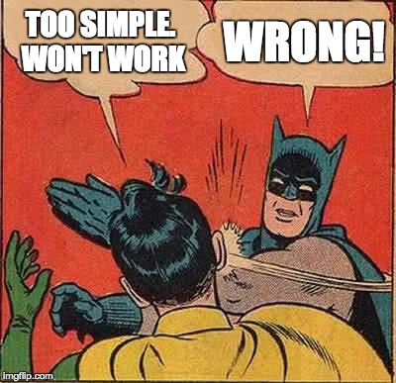

Slide 65
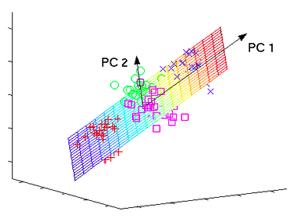
GALE’s clustering = fast analog for PCA (so GALE is a heuristic spectral learner)
ai4se.net
65

Slide 66
This talk
What is search-based SE?
Why use less CPU for SBSE?
How to use less CPU
Refactor the optimizer:
Add in some data mining
Experimental results
Related Work
Future work
A challenge question:
Are we making this too hard?
ai4se.net
66

Slide 67
Sample models
Benchmark suites (small)
SE models
The usual suspects: goo.gl/FTyhkJ
2-3 line equations
Fonseca, Schaffer, woBar. Golinski,
Also, from goo.gl/w98wxu
The ZDT suite :
The DTLZ suite
On-line at: goo.gl/nv2AVK
XOMO: goo.gl/tY4nLu COCOMO software effort estimator + defect prediction + risk advisor
POM3: goo.gl/RMxWC Agile teams prioritizing tasks
Tasks costs and utility may subsequently change
Teams depend on products from other teams
Internal NASA models:
CDA: goo.gl/wLVrYA
NASA’s requirements models for human avionics

Slide 68
Comparison algorithms
What we used (in paper)
Since paper
NSGA-II (of course)
SPEA2
Selected from Sayyad et al’s ICSE’13 survey of “usually used MOEAs in SE”
Not IBEA:
BTW, I don’t like IBEA, just its continuous domination function
Used in GALE
Differential evolution
MOEA/D
?NSGA III
Some quirky “bunching problems”

Slide 69
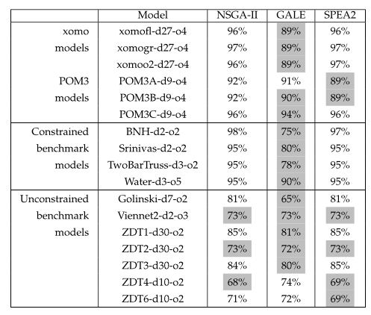
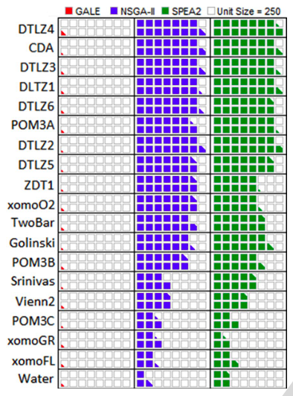
GALE: one of the best, far fewer evals
Gray: stats tests: as good as the best
ai4se.net

Slide 70
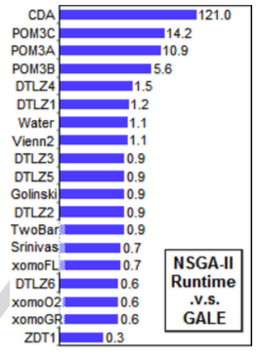
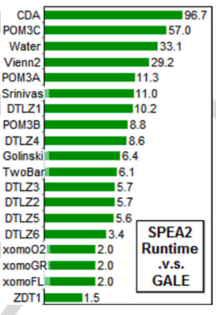
For small models, not much slower For big models, 100 times faster
ai4se.net

Slide 71
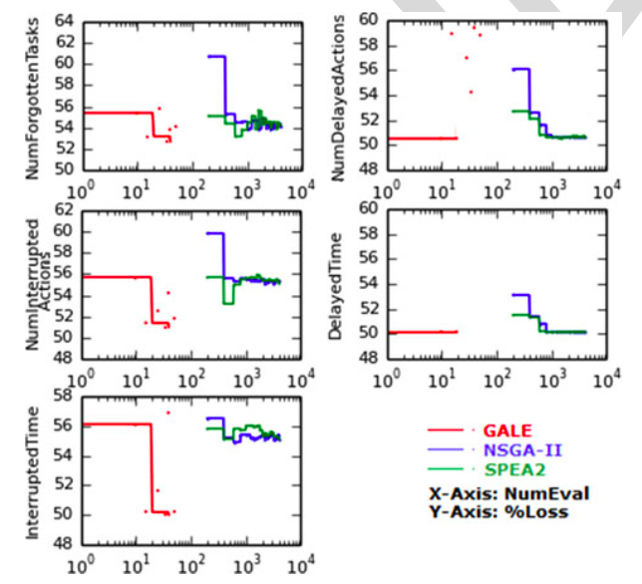
On big models, GALE does very well
NASA’s requirements models for human avionics
• GALE: 4 mins
• NSGA-II: 8 hours
ai4se.net

Slide 72
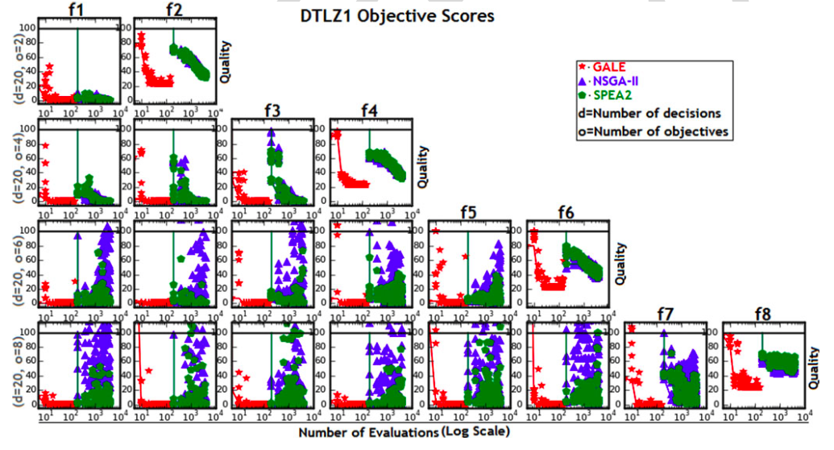
DTLZ1:from 2 to 8 goals
ai4se.net

Slide 73
This talk
What is search-based SE?
Why use less CPU for SBSE?
How to use less CPU
Refactor the optimizer:
Add in some data mining
Experimental results
Related Work
Future work
A challenge question:
Are we making this too hard?
ai4se.net

Slide 74
Related work (more)
[X] = reference
in paper
Active learning [8]
Don’t evaluate all,
Just the most interesting
Kamvar et al. 2003 [33]
Spectral learning
Boley , PDDP 1998 [34]
Classification, recursive descent on PCA component
O(N²), not O(N)
SPEA2, NSGA-II, PSO, DE, MOEA/D, Tabu..
All O(N) evaluations
Various local search methods (Peng [40])
None known in SE
None boasting GALE’s reduced runtimes
Response surface methods Zuluaga [8]
Parametric assumptions about Pareto frontier
Active learning

Slide 75
This talk
What is search-based SE?
Why use less CPU SBSE?
How to use less CPU
Refactor the optimizer:
Add in some data mining
Experimental results
Related Work
Future work
A challenge question:
Are we making this too hard?
ai4se.net

Slide 76
Future work
More Models
More Tool Building
Siegmund & Apel’s runtime configuration models
Rungta’s NASA models of space pilots flying MARS missions
100s of Horkoff’s softgoal models
Software product lines
Explanation systems
Complex MOEA tasks solved by reflecting on only a few dozen examples
Human in the loop guidance for the inference?
There remains one loophole GALE did not exploit
So after GALE comes STORM,
Work in progress

Slide 77
This talk
What is search-based SE?
Why use less CPU for SBSE?
How to use less CPU
Refactor the optimizer:
Add in some data mining
Experimental results
Related Work
Future work
A challenge question:
Are we making this too hard?
ai4se.net

Slide 78
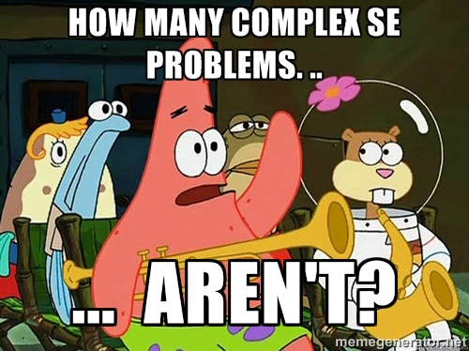
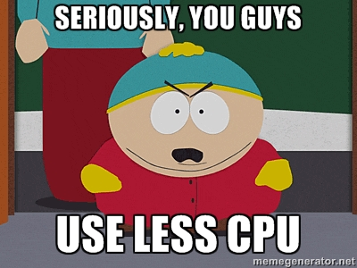

Slide 79
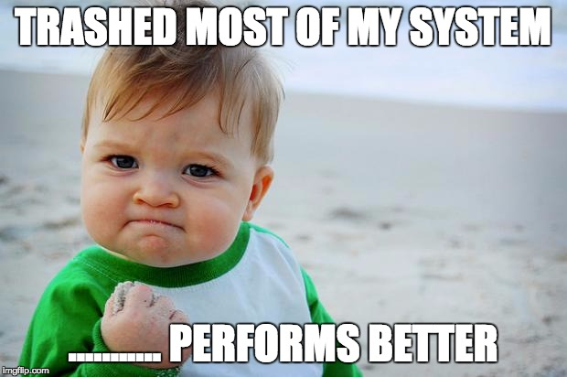
GALE’s dangerous idea
Simple approximations exist for seemingly complex problems.
Researchers jump to the complex before exploring the simpler.
Test supposedly sophisticated vs simpler alternates (the straw man).
My career: “my straw don’t burn”
ai4se.net

Slide 81
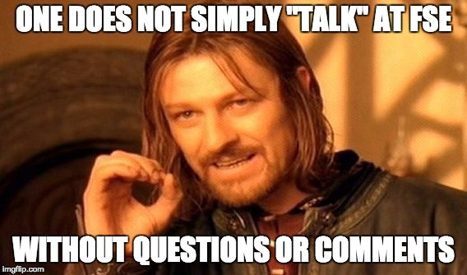
Slides: tiny.cc/gale15
Software: tiny.cc/gale15code
ai4se.net

